Slide 1
National Sheriffs Association February 1, 2026 Legal Update
What Process Is Due:
Loudermill and Name Clearing Hearings
Wayne Evans, Esq.
Florida Sheriffs Association
General Counsel

Slide 2
TOPICS:
Due Process/Loudermill Hearings
Liberty Interest/Name Clearing Hearings

Slide 3

DUE PROCESS
The due process clause of the 14th Amendment provides “ nor shall any state deprive any person of life, liberty or property, without due process of law.“
U. S. Const. Amend. XIV s.1

Slide 4
DUE PROCESS
A public employee may establish entitlement to procedural due process by showing a property interest in his or her position
Board of Regents v. Roth, 408 U. S. 564, 577 (1972).

Slide 5

DUE PROCESS
The concept of a property interest has been defined by the United States Supreme Court as a legitimate expectation of continued employment.
Bishop v. Wood, 426 U.S. 341, 345 (1976).

Slide 6

DUE PROCESS
The legitimate expectations of continued employment establishing property interests are created, and their dimensions are defined by state law.
Cleveland Bd. of Education v. Loudermill, 470 U. S. 532, 538 (1985).

Slide 7
DUE PROCESS
Florida is an at-will employment state.
Cardinale v. S. Holmes, Inc., 2008 U.S. Dist. Lexis 21716 *17 (M.D. Fla. March 19, 2008).
Deputy sheriffs, corrections officers, and civilian employees serve at the pleasure of the sheriff. Their selection and retention comes under the absolute control of the sheriff. They had no property interest in their positions.
Stough v. Gallagher, 967 F. 2d 1523, 1530 (11th Cir. 1992).

Slide 8

DUE PROCESS
Career and Civil Service Acts and Collective Bargaining Agreements, requiring just cause to dismiss or discipline, create a property interest and rights to procedural due process.
Loudermill, 470 U.S. 532, at 540-41 (1985).

Slide 9

DUE PROCESS
Arrangements in which a public employee may be terminated only for cause create a property interest that would require due process before termination.
Warren v. Crawford, 927 F. 2d 559, 562 (11th Cir. 1991).

Slide 10

DUE PROCESS
Internal personnel policy provisions
are not the equivalent of a statutory civil
service system and do not create a
property interest.
Stough v. Gallagher, 967 F.2d 1523 (11th Cir 1992

Slide 11
DUE PROCESS
14th Amendment due process rights require:
Notice and a meaningful opportunity to be heard, appropriate to the nature of the case.
Pre-disciplinary conference and post-termination hearing satisfy due process.
Loudermill, 470 U.S. 532, at 548 (1985).

Slide 12
DUE PROCESS
An essential principle of due process is that a deprivation of life, liberty, or property be preceded by notice and an opportunity for hearing appropriate to the nature of the case. The root requirement of the due process clause is that an individual will be given an opportunity for a hearing before being deprived of any significant property interest.
Loudermill, 470 U.S. 532, at 545

Slide 13

DUE PROCESS
The employee is entitled to oral or written notice of the charges against him, an explanation of the employer’s evidence, and an opportunity to present his or her side of the story.
Loudermill, 470 U.S. 532, at 546 (1985).

Slide 14
DUE PROCESS
Notification of charges, oral or written, satisfies notice requirement.
Opportunity to be heard satisfied by subject officer interview and pre-disciplinary conference.
Harrison v. Wille, 132 F.3d 679 (11th Cir. 1998)

Slide 15
DUE PROCESS
The predetermination hearing need not definitively resolve the propriety of the charge. It should be an initial check against mistaken decisions – essentially a determination of whether there are reasonable grounds to believe the charges against the employee are true and support the proposed action.
Loudermill, 470 U.S. 532, at 545-46 (1985).

Slide 16
DUE PROCESS: Best Practices
Notice of Proposed Discipline
State Policies Violated
Factual Basis
Recommended Discipline
Progressive Discipline or Pattern of Conduct, if Applicable.

Slide 17

DUE PROCESS
In general, something less than a full evidentiary hearing is sufficient prior to adverse employment action.
Loudermill, 470 U.S. 532, at 545 (1985).

Slide 18
DUE PROCESS: Fifth Amendment
Deputy was not compelled to waive Fifth Amendment rights by appearing at pre-disciplinary conference or denied meaningful opportunity to be heard. The deputy’s choice to speak or remain silent did not violate the Fifth or Fourteenth Amendments.
Pre-disciplinary conference is voluntary – employee’s statements cannot be compelled.
Harrison v. Wille, 132 F. 3d 679, 684 (11th Cir. 1998).
Do not read Garrity warnings prior to employee’s statement.

Slide 19

DUE PROCESS
Employee may be suspended without pay provided that there is a sufficiently prompt post-suspension hearing. “[T]he Government does not have to give an employee charged with a felony a paid leave at taxpayer expense.”
Gilbert v. Homar, 520 U.S. 924, 932 (1997).

Slide 20
DUE PROCESS: Best Practices
Notice of Final Action:
Refer to the results of any pre-disciplinary conference.
Reiterate charges against the employee.
Refer to the notice of proposed discipline for factual basis; there is no need to repeat the facts.
State whether progressive discipline or pattern of conduct is applicable.
State any remedies available and timeframe.

Slide 21
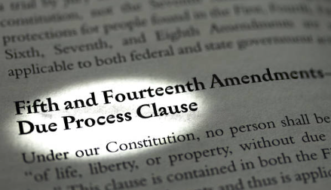
LIBERTY INTEREST
14th Amendment right requires notice of meaningful opportunity for employee who is discharged to “clear name” and present his or her side of the story.
Codd v. Velger, 429 U.S. 624, 627 (1997).

Slide 22

LIBERTY INTEREST
Process due for name clearing hearing is less stringent than process due for deprivation of property interest. Same procedures used to contest deprivation of property interest are more than sufficient for liberty interest.
Harrison v. Wille, 132 F. 3d 679, 683 n.9 (11th Cir. 1998)

Slide 23
LIBERTY INTEREST
Name clearing hearing may be satisfied by:
Subject officer interview
Pre-disciplinary conference
Post-termination conference
Dressler v. Jenne, 87 F. Supp. 2d 1308, 1314-15 (S.D. Fla. 2000)

Slide 24

LIBERTY INTEREST
Unlike procedural due process rights, liberty interest name clearing applies to probationary, at-will employees.
Buxton v. Plant City, 87 F.2d 1037, 1045 n.14 (11th Cir. 1989).

Slide 25
LIBERTY INTEREST
Elements of claim:
(1) false statement
(2) of a stigmatizing nature
(3) attending discharge
(4) made public
(5) by public employer
(6) without a meaningful opportunity for employee name clearing.
Buxton v. Plant City, 871 F.2d 1037, 1042-43 (11th Cir. 1989)

Slide 26
LIBERTY INTEREST
Press release following dismissal of director of animal services division –
animals were unnecessarily euthanized contrary to policy.
Failure to give notice of right to name clearing hearing violated liberty interest.
Johnston v. Borders, 724 Fed. Appx. 762, 767 (11th Cir. 2018).

Slide 27
NAME CLEARING HEARING
Liberty Interest “Stigma Plus” test requires showing that employee was stigmatized and denied a legal right (like a job or continued employment) for a successful claim, not just a promotion.
Connor v. City of West Palm Beach, 250 F. 3d 1299 (11th Cir 2001)

Slide 28
NAME CLEARING HEARING
The opportunity for a name clearing hearing is not as strict as process required before one can be deprived of property interest.
It may be held before or after the publication because it’s provided simply to clear reputation.
Campbell v. Pierce County, 741 F. 2d 1342 (11th Cir. 1984)

Slide 29
LIBERTY INTERST
Because Plaintiff voluntarily resigned, she did not establish deprivation of liberty interest even if she wasn’t informed of opportunity for name clearing hearing.
Rademakers v. Scott, 2009 U.S. Dist. Lexis 103572 (M.D. Fla. 2009)

Slide 30

LIBERTY INTEREST
Post-termination comments, e.g. press release or comments to media, defamatory to employee may violate liberty interest rights.
Offer name clearing hearing.

Slide 31
LIBERTY INTEREST: Best Practices
Have a pre-disciplinary conference for every dismissal.
Investigation completed post-termination:
Offer opportunity to be interviewed.
Send completed investigation to employee and offer name-clearing hearing.

Slide 32
DUE PROCESS – Notice of Proposed Discipline
State policies violated
Factual bases
Recommended discipline
Progressive discipline or pattern of conduct if applicable

Slide 33
VOLUNTARY RESIGNATIONS
Factors to be considered in determining if resignation was voluntary or coerced:
(1) whether employee understood consequences of decision
(2) time allotted to decide
(3) whether employee had a choice about effective date
(4) whether decision was made with advice of counsel
Hargray v. City of Hallandale, 57 F. 3d 1560m 1567 (11th Cir. 1995)

Slide 34
VOLUNTARY RESIGNATIONS
Employee’s resignation when she learned that she likely would be terminated due to investigation which sustained conduct unbecoming and untruthfulness charges held to be voluntary.
Rademakers v. Scott, 350 Fed. Appx. 408 (11th Cir. 2009)

Slide 35
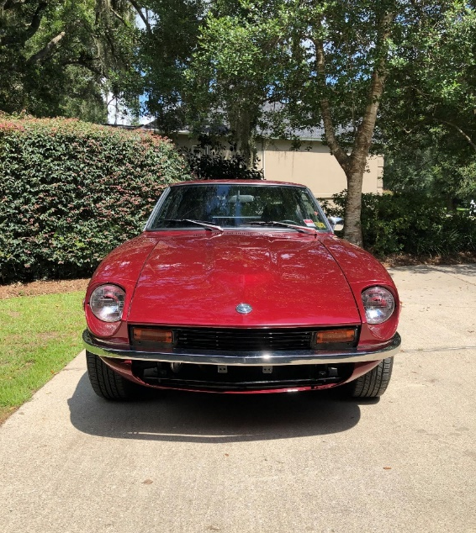
QUESTIONS?

Slide 36
THANK YOU FOR YOUR ATTENTION
Wayne Evans, Esq.
Allen, Norton & Blue, P.A.
906 North Monroe Street
Tallahassee, FL 32303
(850) 561-3503
revans@anblaw.com

