Slide 1





Slide 2

NSA Jails, Detention & Corrections Committee Meeting January 31st, 2026 WELCOME

Slide 3
“Thank You” to our Sponsor ECC-IMPERIUM

Slide 4

COSSUP OPPORTUNITIES

Slide 5
Tara Kunkel
Tara@rulostrategies.com
804-914-2797

Slide 6
Jails and Justice Support Center
A Vital Resource for the Nation’s Jails
Notes:
Poll: Who’d heard of JJSC

Slide 7
Connect With Us Panda J. Adkins adkinsp@cna.org Keri Richardson richardsonk@cna.org Sherry Woods svwoods50@comcast.net
jailsupportcenter.org

Slide 8
ACCESS TO EVIDENCE-BASED MATERNAL HEALTH AND OTHER WOMEN’S HEALTH CARE IN OUR NATION’S JAILS
Draft resolution discussion January 31, 2026
Carolyn Sufrin, MD, PhD, CCHP
Department of Gynecology and Obstetrics
Johns Hopkins School of Medicine
Johns Hopkins Bloomberg School of Public Health
csufrin@jhmi.edu

Slide 9
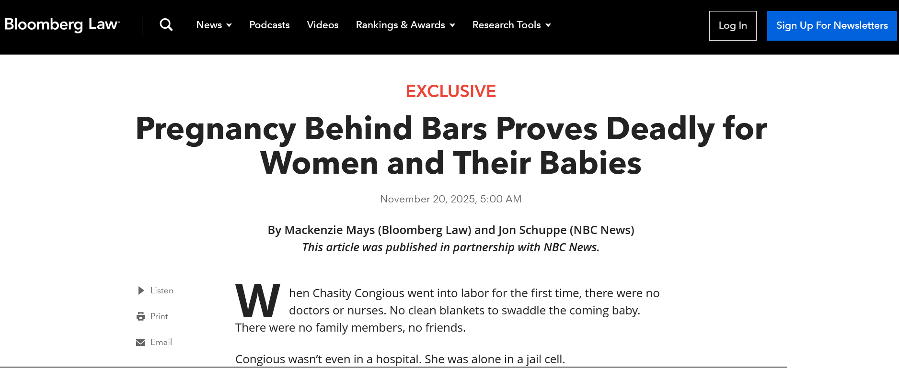


Slide 10

“Most jails in the country are not equipped and are not trained to handle most pregnant women.”
-Sheriff Gabriel Morgan
54 lawsuits from pregnant women alleging mistreatment and neglect by jails. Including:
- 1 maternal death (ruptured ectopic pregnancy)
- 1 newborn death (born in jail cell, cord wrapped around the neck)
Report of pregnancy in jail lawsuits
Notes:
Most of the women in these cases were arrested on nonviolent charges that included probation violations, forgery and drug possession.

Slide 11
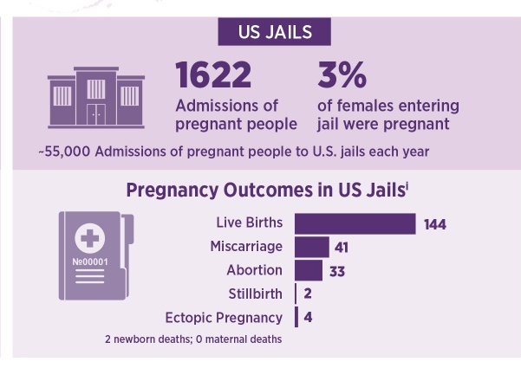

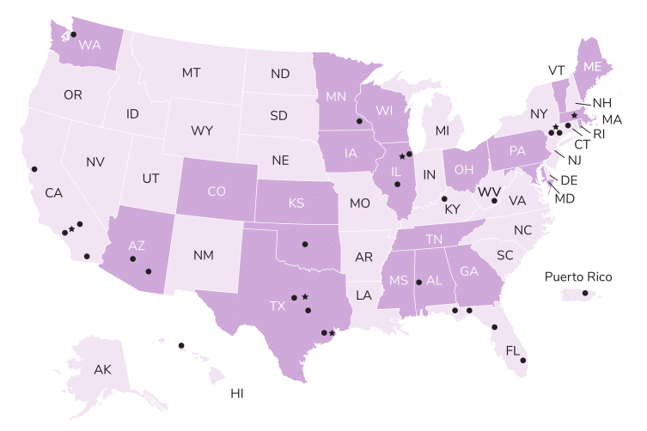
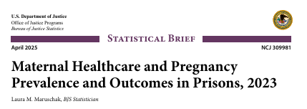
How many pregnant women are in custody?
2016-2017
224 pregnancies ended in 6 jails
~55,000 admissions of pregnant women/year to jails
Notes:
No maternal deaths
Infant placement
Data not disaggregated by race or GA on entry

Slide 12
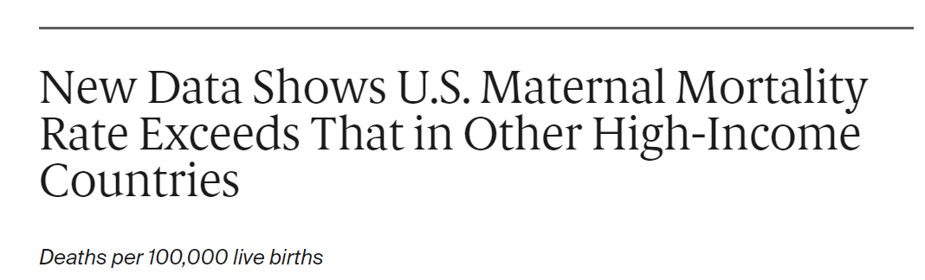
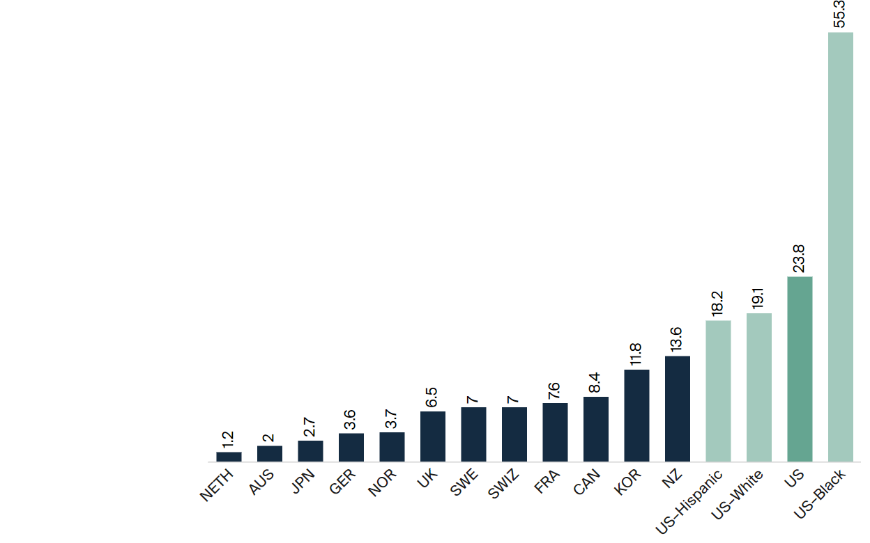
Source: Munira Z. Gunja, Evan D. Gumas, and Reginald D. Williams II, “The U.S. Maternal Mortality Crisis Continues to Worsen: An International Comparison,” To the Point (blog), Commonwealth Fund, Dec. 1, 2022. https://doi.org/10.26099/8vem-fc65
Notes:
TRANSITION: RACIAL INEQUITIES
The maternal mortality ratio is defined by the World Health Organization as the death of a woman while pregnant or within 42 days of termination of pregnancy, irrespective of the duration and site of the pregnancy, from any cause related to or aggravated by the pregnancy or its management but not from accidental or incidental causes.

Slide 13
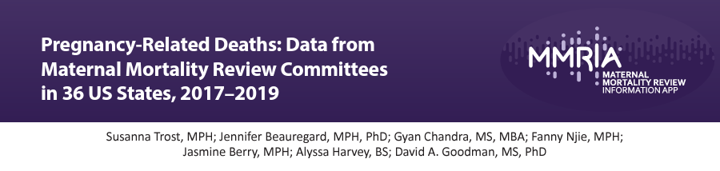

#1 Cause of Maternal Death = Mental Health Conditions
Notes:
10% of maternal deaths are opioid related
It is estimated that among the nearly 55,000 admissions of pregnant people to jails each year, 14%, or roughly 7,700, have OUD, and 3,000 to prisons with 26% or 780 with OUD.^{6,7} Total >8,000 pregnant people to P/J each year with OUD. Rates of OUD in pregnancy have quadrupled in the US from 1999-2016, and with fatal consequences—by 2016, 10% of pregnancy and postpartum deaths were opioid related.^{8–11}
Stigma, intergenerational impact

Slide 14
NATIONAL SHERIFFS’ ASSOCIATION SUPPORTS ACCESS TO EVIDENCE-BASED MATERNAL HEALTH AND OTHER WOMEN’S HEALTH CARE IN OUR NATION’S JAILS
WHEREAS, our nation’s Sheriffs oversee the vast majority of local jails and, as such, have the responsibility to maintain the safety and security of the facility for all who live and work within; and,
WHEREAS, there are more than 1.7 million arrests of females who pass through our nations jails annually; and
WHEREAS, women in jail have distinct and often time-sensitive health care needs that includes access to: pregnancy and postpartum care; contraception methods for those who want to avoid pregnancy upon release; screening and treatment for sexually transmitted infections; an adequate supply of menstrual products; trauma informed care; mental health care; substance use disorder treatment; and
WHEREAS, sixty percent of incarcerated women are mothers and primary care givers to young children;

Slide 15
WHEREAS, incarceration of mothers has been defined as an adverse childhood experience (ACE), putting their children at increased risk of poverty, trauma, poor education, and future incarceration; and
WHEREAS, family-friendly and frequent visitation between mothers and children, especially when they are infants, helps to maintain important bonds that may reduce the risk of adverse outcomes for children; and
WHEREAS, from 2016-2017 it was estimated that there are 55,000 admissions of pregnant women to U.S. jails; and
WHEREAS, some of these women will give birth, have miscarriages, abortions, and other pregnancy outcomes while they are in custody; and
WHEREAS, there are no comprehensive, accurate, or updated data available on the number of pregnant or postpartum women in our nation’s jails and what the outcomes of those pregnancies are; and

Slide 16
WHEREAS, the U.S. has the highest rate of maternal mortality of any high-income country; and
WHEREAS, more than half of maternal deaths occur in the post-partum period (i.e., up to 12 months after delivery), when some women are still incarcerated, and
WHEREAS, most maternal deaths are preventable when there is access to timely and appropriate health care; and
WHEREAS, pregnant and postpartum women in jail have numerous high risk medical and psychosocial conditions that put them at increased risk of adverse outcomes; and
WHEREAS, providing pregnant and postpartum women in jail with access to comprehensive prenatal care and to emergency pregnancy care by qualified providers helps to ensure safe outcomes for mothers and infants; and

Slide 17
WHEREAS, untreated mental health conditions and drug overdose are leading causes of maternal mortality; and
WHEREAS, seventy percent of women in jails have a mental health condition; and
WHEREAS, seventy percent of women in jails have a substance use issue, with at least 16% of pregnant women in jails having opioid use disorder; and
WHEREAS, there are maternal deaths, stillbirths, and infant deaths in jails when pregnant womens’ urgent symptoms and health care need are not addressed; and
WHEREAS, providing pregnant women in jail with timely access to comprehensive pregnancy and postpartum care by a qualified provider and with emergency referral when there are “urgent maternal warning signs” contributes to positive outcomes for them and their babies and can reduce the risk of death; and

Slide 18
WHEREAS, pregnant individuals with OUD have distinct needs, including: avoiding opioid withdrawal due to the maternal and fetal harms; access to continuation and initiation of MAT/MOUD in custody during pregnancy and postpartum with methadone and buprenorphine (naltrexone is not used in pregnancy); and care that is specialized to their needs, all of which are necessary to optimize outcomes for pregnant individuals and their babies; and,
WHEREAS, breast milk has numerous established health benefits for infants and mothers, is safe for infants of mothers stable on MAT/MOUD, and is feasible to provide in jail settings; and
WHEREAS, female staff working in jails who are pregnant may have pregnancy emergencies or need accommodations for pumping breastmilk; and
WHEREAS, jails, especially those in rural areas, may have limited resources and training to address and collect data about pregnant, postpartum, and non-pregnant women’s health care needs and outcomes;

Slide 19
NOW, THEREFORE, BE IT RESOLVED, that the National Sheriffs’ Association (NSA) supports the provision in all jails, regardless of size or location, of comprehensive routine and urgent pregnancy, postpartum, care, care for mental illness, care for opioid use disorder, support for breast feeding, family-friendly visitation with children, contraceptives, and other women’s health care needs, such as menstrual supplies at no cost to women, in line with recommendations of the National Commission on Correctional Health Care, Bureau of Justice Assistance, U.S. Department of Justice, American Society for Addiction Medicine, and the American College of Obstetricians Gynecologists; and
BE IT FURTHER RESOLVED, that the NSA supports the collaboration of jails with local public health agencies, women’s health care providers, and relevant community organizations to collect data on pregnancy, provide qualified pregnancy care, and other essential services; and
BE IT FURTHER RESOLVED, that the NSA supports training of frontline staff to recognize potential signs of labor and other pregnancy emergencies, using tools such as the CDC’s “Urgent Maternal Warning Signs” rubric, and refer those with such emergencies for appropriate care.

Slide 20



Innovative Approaches to Pregnant and Postpartum Women in Jail: Doula Programs and Custody Staff Training
MONDAY FEBRUARY 2
11AM-12PM
COMMERCE ROOM
Sheriff Jose Quiroz
Kenda Sutton-El
Carolyn Sufrin

Slide 21
Federal Partners Update: BJS Jail Data
National Sheriffs’ Association 2026 Winter Conference Jails, Detention and Corrections Committee
Todd Minton, Chief Zhen Zeng, Statistician BJS – Jails and Community Corrections Statistics Unit
January 31, 2026

Slide 22
What We’ll Cover
Administrative jail surveys
Inmate surveys
Recent releases and upcoming products
New jail data tools

Slide 23
Census of Jails Updates: 2024 Data Release
Preliminary data released in December 2025 (admissions, incarceration rates, demographics)
Jail Inmates, 2024 full report planned for spring 2026
Opioid Use Disorder Screening and Treatment in Local Jails, 2019 and 2024 planned release late 2026

Slide 24
Census of Jails Updates: 2025 Collection
Data collection began January 2026
Transition to an annual census
Benefits
More timely state and local data; fewer gaps between releases
Up-to-date national jail frames to support other BJS surveys
Simplified and streamlined form to reduce respondent burden

Slide 25
Indian Country Jails
Survey of Jails in Indian Country (SJIC):
Jails in Indian Country, 2024 released in December 2025
2025 data collection completed
2025 full report planned for spring 2026
Engaging facilities and stakeholders to collect feedback that enhances the SJIC portfolio and informs the development of a facility dashboard.

Slide 26
Maternal Health Cognitive Test in Local Jails
Maternal Health Cognitive Test:
Study initiated in response to House Report 116-455 to gather data on the number of pregnant women in custody, pregnancy outcomes, and the provision of care and services
Questionnaire tested in 20 jails
Results are currently being analyzed, and recommendations will be made regarding the appropriateness of conducting a national data collection.

Slide 27
Inmate Surveys: NIS-4
National Inmate Survey, 2023–24 (NIS-4):
20,000+ inmates in 250 facilities were interviewed
Sexual Victimization in Local Jails Reported by Inmates, 2023–24 released in December 2025
includes national and facility estimates and facility rankings
Reports planned on victim/perpetrator characteristics and facility correlations

Slide 28
Inmate Surveys: SILJ
Survey of Inmates in Local Jails (SILJ):
Fieldwork from Nov. 2024 through mid-April 2025
Over 4,000 inmates in ~450 facilities were interviewed
Multiple reports in planning
Topics covered
Demographics & family background
Offenses & detentions status
Criminal history
Victim characteristics
Gun possession/use
Substance use & treatment
Physical & mental health
Misconduct in jail
Programs and services

Slide 29
New Data Tool: Jails Data Dashboard
Under development: A new interactive dashboard for national and state-level jail populations.
Key Features:
Modernized Access: Moves data from static PDF reports to a faster, web-based release
User-Friendly: Point-and-click exploration of trends and easy comparisons without needing statistical software
Accessible: Supports easy data exports in multiple formats
Part of BJS modernization

Slide 30
Summary: Key Advances in BJS Jail Statistics
Jail data are becoming more timely and more frequent
BJS has moved to an annual Census of Jails starting yearend 2025.
This ensures faster state and local jail statistics with fewer gaps between releases.
BJS is expanding jail data coverage
Inmate Surveys (NIS, SILJ): New data on criminal history, inmate health, behavior, programs, and more from large-scale inmate surveys
Opioid screening and treatment practices
Maternal health and pregnancy care
Jail data are becoming easier to access and use
Jail Inmates report series transitioned from PDF to web-based release in 2023.
Jails Data Dashboard coming in late 2026, as the primary platform for state and local data.

Slide 31
Questions? Todd.Minton@usdoj.gov Zhen.Zeng@usdoj.gov

Slide 32

Introduction to ICE’s 287(g) Program

Slide 33


Section 287(g)
Section 287(g) of the Immigration and Nationality Act (INA) is codified in 8 U.S.C. §1357(g) and allows ICE to delegate certain immigration enforcement actions to trained state and local law enforcement partners.

Slide 34

The 287(g) Program’s partnerships are voluntary and formed by a standardized Memorandum of Agreement — known as an “MOA”
Memorandum of Agreement
The MOA is a formal agreement that specifies:
Delegated authorities
ICE supervision and program oversight
Training requirements
Complaint procedures
Release of information
Termination

Slide 35
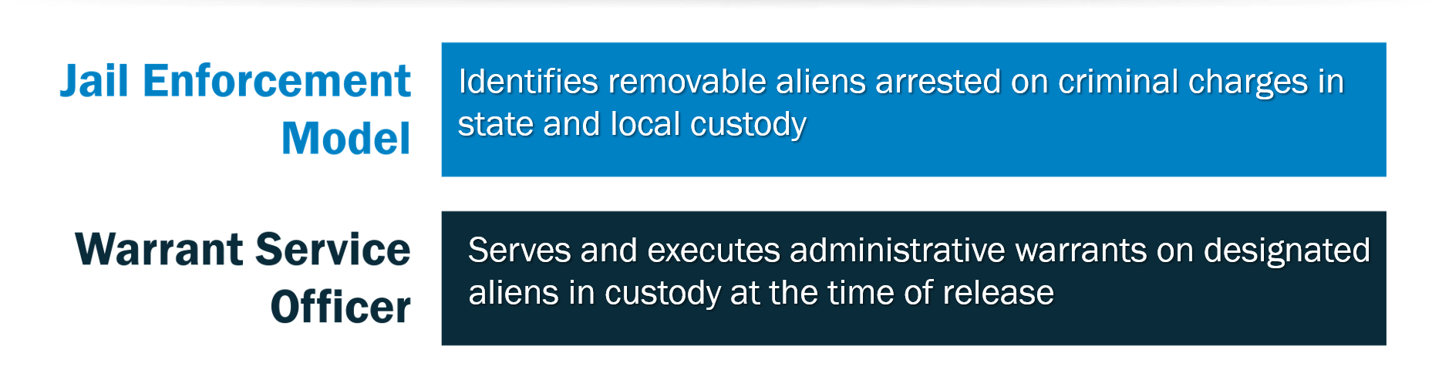
Models and Programs

Slide 36
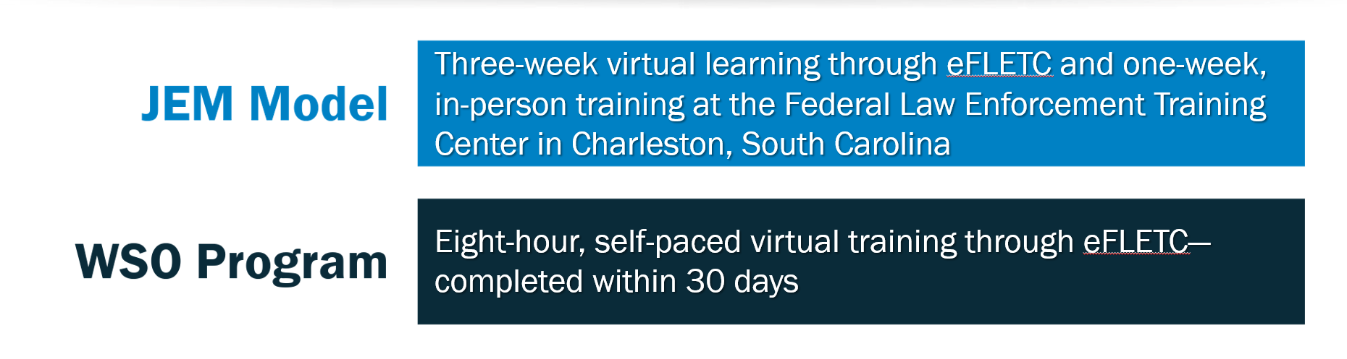
Training

Slide 37
608
Current Partnerships*
Signed MOAs covering 34 states
151
JEM site programs in 32 states
457
WSO program sites in 34 states
*As of January 29, 2026

Slide 38
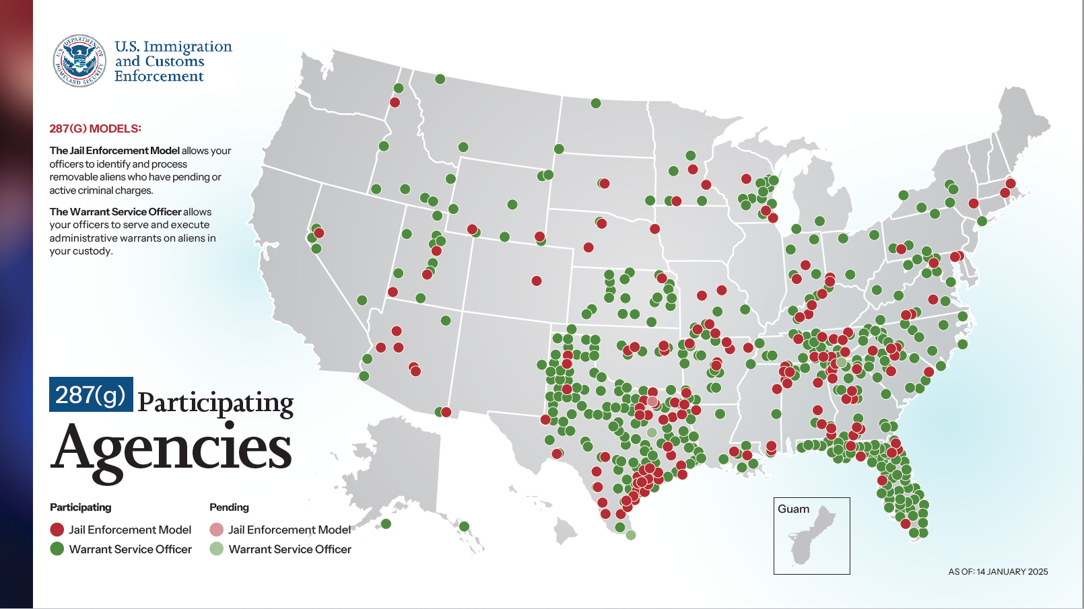
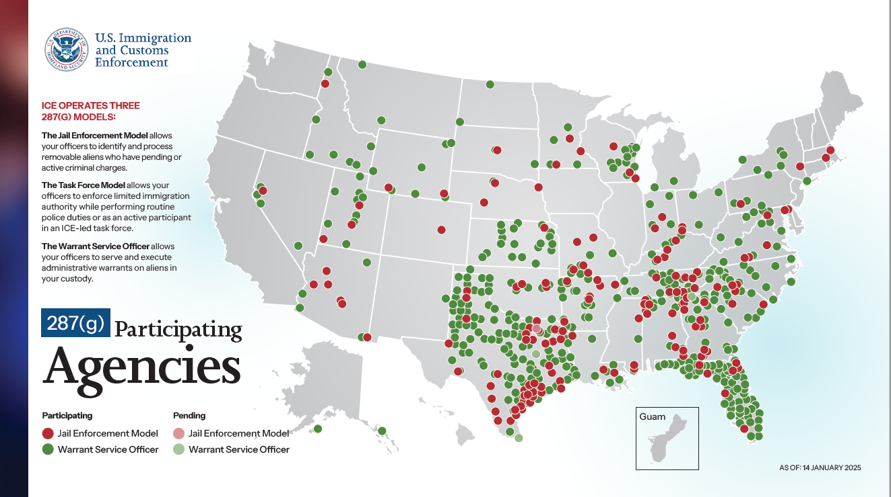
Current Program Map

Slide 39

Program Oversight
ICE’s Office of Professional Responsibility conducts biennial inspections of JEM’s programs to measure program compliance.
National program managers conduct biennial reviews of the WSO programs
to measure compliance.
Field program managers and other ICE supervisors review and sign files and documents generated by 287(g) partners to ensure compliance with MOAs and immigration law.

Slide 40

Upon director approval:
JEM Application Process
ERO will notify the LEA of approval
A program manager will coordinate with the LEA to begin ICE training
DIO candidates will undergo a background investigation and clearance by ICE Personnel Security for ICE system access

Slide 41

JEM Application Process
Background cleared DIOs attend and graduate ICE Academy training
ICE issues credentials and provides necessary IT equipment
ICE Field Office Director issues DIO final authorization and certification forms
Program managers complete all final paperwork
Either party can terminate the MOA at any time

Slide 42


Warrant Service Officer
The WSO Program was developed in collaboration with members of the National Sheriffs’ Association and the Major County Sheriffs of America.
It was designed for operational flexibility — providing an opportunity for jurisdictions to participate with ICE who are precluded from honoring ICE detainers at the local level.

Slide 43

Upon director approval:
WSO Application Process
ERO will notify LEA of approval
LEA nominates potential WSO candidates
ICE begins background investigation and clearance of WSO officers
LEAs schedule and complete WSO training
ICE issues authorization paperwork and credentials
Either party can terminate the MOA at any time

Slide 44

Public Safety Benefits
Allows ICE and local law enforcement to identify and remove criminal aliens before their release into the community.
Takes custody of criminal aliens in secure facilities, which reduces risks to communities and officers.
Expands partnerships that allow for working groups between ICE and 287(g) partners that enhance technology and foster information sharing.

Slide 45


How To Join
State and local partners need to complete these steps in join the 287(g) program:

Slide 46
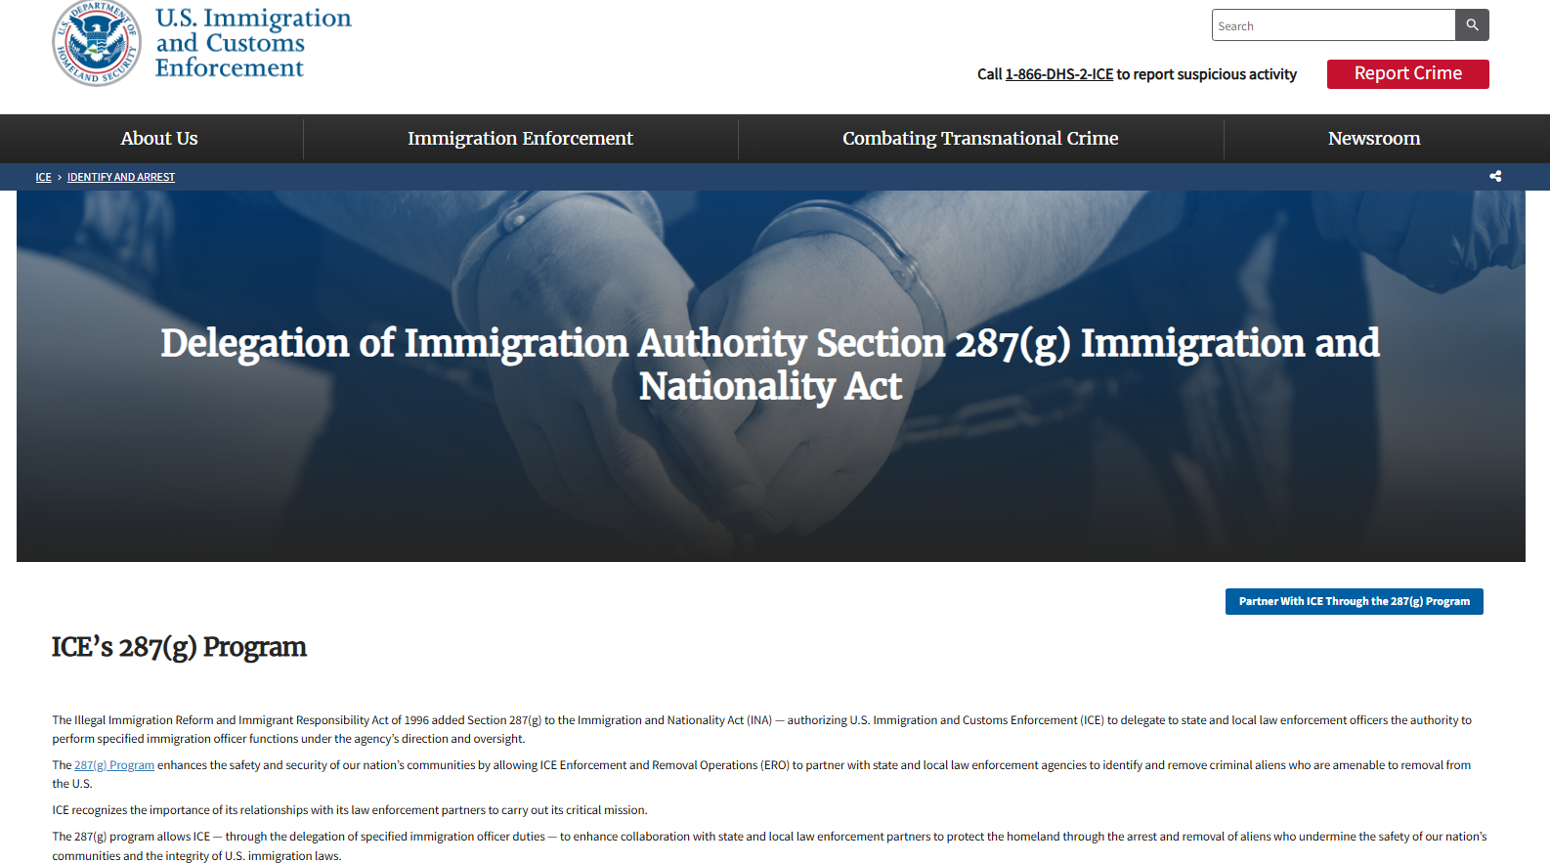
Contact Us
https://www.ice.gov/identify-and-arrest/287g
https://www.ice.gov/287g
ERO287g@ice.dhs.gov
Call 202-732-4207 (M-F 8a-4p)

Slide 47


Slide 48
Health and Reentry: State and Local Innovations and Insights NSA Conference Winter 2026

Slide 49
Disclaimer
This presentation was produced by Grant No. 15PBJA-24-GK-04439-SCAX awarded by the Bureau of Justice Assistance (BJA). The Bureau of Justice Assistance is a component of the Office of Justice Programs, which also includes the Bureau of Justice Statistics, the National Institute of Justice, the Office of Juvenile Justice and Delinquency Prevention, the Office for Victims of Crime, and Office of Sex Offender Sentencing, Monitoring, Apprehending, Registering, and Tracking.
Points of view or opinions in this document are those of the author and do not necessarily represent the official position or policies of the U.S. Department of Justice.

Slide 50


The Health and Reentry Project (HARP)
HARP was established to improve the health and safety of people and communities
Through education and analysis, HARP strengthens policies to expand access to health care for people directly impacted by the justice system
HARP advances implementation to help new policies become a reality that improves peoples’ lives
HARP brings together stakeholders across health care and criminal justice, including people who are directly impacted
.
50

Slide 51
Leveraging Medicaid to Support Health Care at Reentry
April 2023
January 2025
January 2026
CMS releases guidance to states on new reentry 1115 waiver opportunity
National Medicaid policy requiring incarcerated youth receive screening, diagnostics, and case management at reentry
National requirement that prohibits Medicaid termination upon any beneficiary’s incarceration

Slide 52
State 1115 Reentry Waivers: Bringing Medicaid Behind the Walls in the Pre-release Period
With CMS approval, states can provide reimbursement for certain required services up to 90 days prior to release from incarceration
Case management
Medications to treat substance use disorders
30-day supply of all prescription medications upon release
Corrections agencies are starting to go live with pre-release services
CA has initiated pre-release services in their prison system and certain counties
MT, NH, NM and WA and have gone live in some facilities
Additional states have stated that services may start in the next 6-12 months
Pending Waivers
Approved Waivers

Slide 53
Medicaid and CHIP Policies for Youth Who Are Incarcerated
Who
What
When
30 days prior to release OR not later than one week, (or “as soon as practicable”) after release
Focus Population
Eligible for Medicaid or CHIP (based on income and other factors; varies by state)
Under 21 (or under 26 if former foster youth)
Post-Adjudication
Is within 30 days of scheduled release
Screening and Diagnostic (e.g., physical, dental, behavioral health)
30 days prior to release AND for at least 30 days following release
Targeted Case Management (e.g., referrals to appropriate services)
Notes:
Since January 2025, states are required to use Medicaid and the Children’s Health Insurance Program (CHIP) to cover limited services for incarcerated youth who are soon to be released
This applies to all Medicaid beneficiaries in custody following adjudication who:
Are under age 21
Are former foster youth under age 26
The policy requires all states:
To provide screenings and diagnoses and service referrals for youth in 30 days before OR shortly after release
To provide case management in the 30 days before AND at least 30 days following release
This applies to all state, local and tribal facilities where youth are incarcerated post-adjudication (prisons, jails, juvenile justice, and youth corrections)
Additional state option to use Medicaid to cover comprehensive services for youth pending disposition of charges

Slide 54
Medicaid Suspension Requirements
As a result of Medicaid’s longstanding prohibition on paying for services for individuals who are incarcerated, corrections has historically terminated Medicaid coverage for individuals entering custody.
With provisions applying January 1, 2026, state plans are prohibited from terminating enrollment due to incarceration.
Moving forward, states must suspend, rather than terminate Medicaid. This change can help correctional facilities take fuller advantage of Medicaid-covered services.

Slide 55
Anticipated Resources for Jails: Medicaid Suspension and Reinstatement Technical Considerations
To support jails as they seek to comply with provisions that prohibit terminating Medicaid coverage, HARP has developed resources to support correctional agencies as they navigate this change.
Technical Considerations for Operationalizing Suspension
HARP’s forthcoming key considerations document will help jails to:
Understand federal requirements around termination and suspension
Distinguish between the different types of suspension and understand the implications of each
Assist in performing a self-assessment of current practices
Support the identification of gaps within jail operations
Facilitate coordination with state Medicaid partners

Slide 56
Anticipated Resources for Jails: Operational Checklist on Suspension and Reinstatement
In addition to its Technical Considerations document, HARP has also developed an operational checklist to support jails in developing workflows and processes to streamline Medicaid suspension and reinstatement
Suspension and Reinstatement Operational Checklist
HARP’s forthcoming checklist provides discrete steps for jails to:
Identify the right staff to lead suspension and reinstatement operational processes
Find the right points of contact within Medicaid to support process improvement
Develop a comprehensive workflow that improves outcomes and reduces administrative burden
Identify metrics to monitor performance
Improve continuity of care for people exiting jail

Slide 57
Implementation Challenges for Jails
Workforce
Many corrections agencies are running 30% staff vacancy rates
Health care and behavioral health fields also face high vacancy rates
Navigating Corrections’ Operational Realities
Ensuring safety and security
Unpredictable release dates & short stays
Making sure that the physical plant supports health care delivery
Developing and Sustaining New Partnerships
Partnerships with corrections custody, correctional health care, behavioral health, pharmacy, community providers, and managed care plans
Corrections has asked for ongoing support from health agencies
Aligning with programmatic, service, and coverage standards that come with health insurance, while addressing the operational conditions in corrections
Resolving Differences in Health Care Standards
IT Systems Development & Data Sharing
Medicaid enrollment/suspension/reinstatement
Medicaid billing
Sharing medical records/care plans securely

Slide 58

HARP Resources for Jails
At the request of sheriffs, jails and prison systems, HARP produced resources and supported trainings on operations and continuity of care issues to educate the field of correctional leaders about these requirements and opportunities. Materials include:
Consolidated Appropriations Act of 2023 Youth Requirements: Frequently Asked Questions For Jails
Brief Operational Checklist for Post-Adjudicated Youth: A two-page resource with quick, concrete considerations to guide initial implementation of new requirements
Getting Ready: Key Elements for the Implementation of Section 5121 Youth Requirements in Adult Correctional Facilities: A deeper dive, highlighting seven key elements jurisdictions need to think about to be ready to implement the new requirements

Slide 59
Additional Updates for Building Continuity of Care at Release
Recent statutory changes to Medicaid contain key exemptions from community engagement requirements impacting the reentry community.
Two key exemptions for corrections leaders and reentry specialists to be aware of include:
People who are incarcerated or were incarcerated at any time in the three-month period prior to the first day of the month in which they are verifying community engagement
People with SUD, “disabling” mental illness, enrolled in treatment program

Slide 60
Technical Assistance
HARP aims to support sheriffs, jail administrators, and leaders of state corrections agencies to address health-related factors that contribute to crime for reentering individuals, support the development of operations-responsive reentry partnerships in the health sector, and strengthen continuity of care.
Through this TA, HARP has held more than 30 individualized technical assistance sessions with jails/prisons in Louisiana, Michigan, Minnesota, New Mexico, Rhode Island and Texas.
Our TA sessions are flexible and have covered a range of topics, including Medicaid suspension/reinstatement, 1115 reentry waiver basics, how to bill Medicaid, understanding case management, and implementation of CAA 2023, among others.
This technical assistance comes at no cost to participants and can begin quickly.
Scan the QR Code to Request Assistance from HARP:

Slide 61
For more information and/or assistance, email: dryan@healthandreentryproject.org C: 617-549-8582
Scan the QR code to request assistance from HARP:

Slide 62
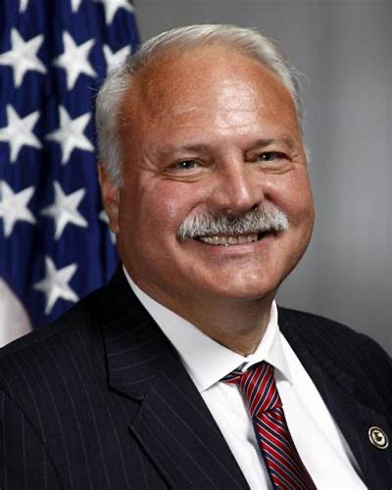

Sheriff Michael J. Ashe Jr. Award: Chief Stephen Amos, NIC Jails Division

Slide 63
Marc F. Stern, MD, MPH Senior Medical Advisor, National Sheriff’s Association marcstern@live.com 360 701-6520 (PST)

Slide 64

www.prainc.com/resource-library/ correctional-healthcare-rfp-toolkit
or

Slide 65

https://www.nationalacademies.org/publications/29232
Strengthening the US Medicolegal Death Investigation System: Lessons Learned from Deaths in Custody

Slide 67
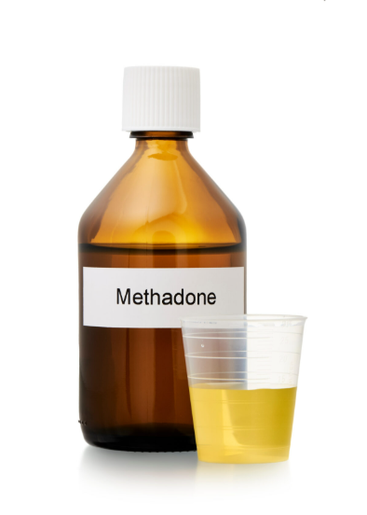




“Prescription”

Slide 69
Public Health Updates Marc Stern Special Assistant to Liesl Hagan

Slide 70
Measles

Slide 71
June 2025 ICE Detention facility NM
14 cases
1st measles outbreak in a facility since 2016
January 2026
ICD Detention facility AZ
1 case

Slide 72
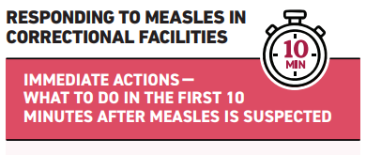

Slide 73
New World Screwworm

Slide 74



Slide 75



CDC Correctional Health Resources
Measles
NW Screwworm
Correctional
Newsletter
75

Slide 77
NSA Updates: Carrie Hill
MOUD Resolution: Renew

Slide 78
NATIONAL SHERIFFS’ ASSOCIATION SUPPORTS THE USE OF FDA APPROVED AND EVIDENCE-BASED MEDICATION FOR OPIOID USE DISORDER (MOUD) IN OUR NATION’S JAILS
Background
In response to the opioid epidemic gripping this country, significant resources to treat Opioid Use Disorder (OUD) have been allocated by federal, state, local, and tribal governments across the country. In December 2016, as part of the 21st Century Cures Act, Congress appropriated $500 million in grants to the states to treat OUD, which can then be passed down to providers as well as local and tribal governments. This and other funding can be utilized to provide treatment, including Medications for Opioid Use Disorder (MOUD), to incarcerated individuals.
WHEREAS, our nation’s Sheriffs oversee the vast majority of local jails and, as such, have the responsibility to maintain the safety and security of the facility for all who live and work within; and,
WHEREAS, more than 10 million individuals pass through our nation’s jails annually; and

Slide 79
WHEREAS, it has been estimated that more than 50% of incarcerated individuals meet the medical criteria for drug dependence or abuse, with adults on parole or supervised release from jail being nearly 3 times more likely to be dependent on or to abuse a substance than their peers; and,
WHEREAS, the criminal justice system is the largest source of referral to addiction treatment; and,
WHEREAS, criminal justice-related costs due to prescription opioid overdose, abuse, and dependence reached approximately $7.7 billion annually; and,
WHEREAS, OUDs are often associated with a revolving door of arrest, incarceration, and release to the streets untreated or undertreated, followed by rearrests and return to incarceration or death; and,

Slide 80
WHEREAS, according to a report by the National Association of Counties and National League of Cities, individuals with opioid dependence who receive little or no treatment while incarcerated are likely to relapse to opioid dependence and criminal behavior, overdose and too often die; comprehensive drug-treatment programs in jails are associated with reduced system costs and,
WHEREAS, evidence strongly supports that the use of MOUD increases the likelihood of successful treatment for individuals with OUDs; and,
WHEREAS, A combination of medications and behavioral interventions have been shown to decrease opioid use, increase treatment retention, reduce overdose, and reduce criminal activity; and,
WHEREAS, MOUD, utilizing the U.S. Food and Drug Administration (FDA)-approved medications methadone, buprenorphine, or naltrexone, is considered a central component of the contemporary standard of care for the treatment of individuals with (OUDs); and,
WHEREAS, pregnant individuals with OUD have distinct needs, including: avoiding opioid withdrawal due to the maternal and fetal harms; access to continue and initiate MOUD in custody during pregnancy and postpartum with methadone and buprenorphine (naltrexone is not used in pregnancy); and care that is specialized to their needs, are all necessary to optimize outcomes for pregnant individuals and their babies; and,
WHEREAS, a disproportionate number of people in jails have substance use disorders (SUDs), incarceration provides a valuable opportunity for identifying SUD, providing treatment, and addressing withdrawal and,
WHEREAS, failing to manage withdrawal symptoms can lead to serious health complications and death; and;

Slide 81
WHEREAS, following the medical guidelines and protocols for managing SUD withdrawal can minimize the risk of SUD related illness or death; and,
WHEREAS, jails can minimize the risk of in-house and post-release overdose by facilitating continued access to MOUD for individuals who are on prescribed FDA-approved MOUD and by facilitating initiation of MOUD for individuals with OUDs who were not receiving MOUD prior to arrest - taking into account individual preferences, clinician judgment and medication diversion potential; and,
WHEREAS, jails can minimize the risk of overdose in-custody and post-release by making naloxone kits and training available to custody staff and releasing incarcerated individuals and their families, respectively; and,
WHEREAS, by partnering with community MOUD providers including opioid treatment programs and substance abuse and counseling programs, jails can facilitate treatment continuity on jail entry and release with these providers; and,
WHEREAS, including MOUD, when appropriate, as a tool in the range of jail-based treatment options, may stem the cycle of arrest, contribute to the maintenance of a safe and secure facility
for incarcerated individuals and staff, and comprehensive drug treatment programs in jails are associated with reduced system costs;
THEREFORE, BE IT RESOLVED, that the National Sheriffs’ Association (NSA) supports the use of FDA-approved and evidence-based Medications for Opioid Use Disorder within the confines of a jail or other secure facility and, when deemed appropriate by a court of competent jurisdiction, as an alternative to incarceration for offenses related to the use of drugs.

Slide 82
Centers for Medicaid and Medicare (CMS) Joint Letter of Support with: NSA, MCSA, NCCHC, SRLEEA, AJA
We respectfully asked that CMS advance the approval process of additional Medicaid Section 1115 Reentry Waiver demonstrations; and
We view approval of additional reentry waivers, as well as renewals of current waivers, as a critical part of achieving the national public safety goals we share with the administration.

Slide 83
CNA/Loudoun County/NSA: “A Randomized Controlled Trial of the Impact of Body-Worn Cameras in the Loudoun County, VA, Adult Detention Center”
The Report “…represents the final research report of the CNA Corporation’s evaluation of body- worn cameras (BWCs) in the Loudoun County, Virginia, Adult Detention Center. The goal of this study was to conduct a rigorous process and impact evaluation of BWCs in a correctional setting to inform researchers and practitioners about the implementation and potential impacts of BWCs on critical correctional outcomes.”
Https://www.ojp.gov/pdffiles1/nij/grants/307338.pdf

Slide 84
Contact Information
Carrie Hill, Esq.
Chief Jail Advisor
National Sheriffs’ Association
Email: Carrie@sheriffs.org
Executive Director
Massachusetts Sheriffs’ Association
Carrie.Hill@mass.gov
Mobile: 612-306-4831

